Slide 1
How to use
HSPICE

Slide 2
Outline
Introduction HSPICE
Write HSPICE code
Example for circuit analysis and ideal OP
Lab - I

Slide 3

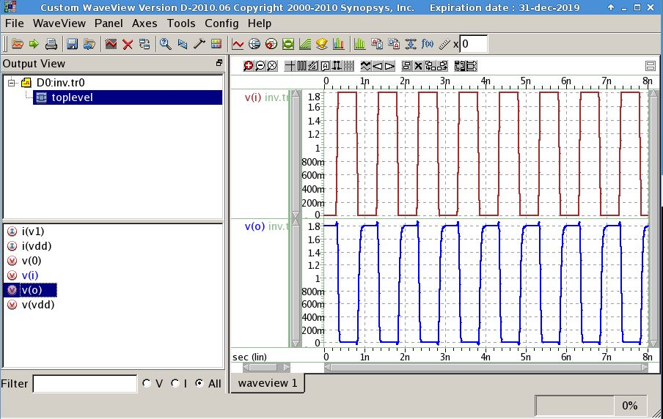
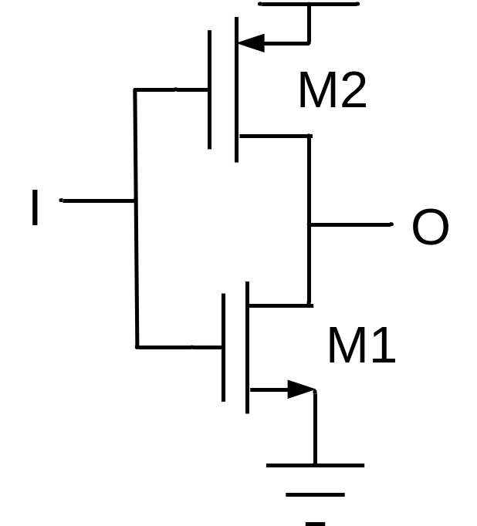
電腦模擬 - I

Slide 4
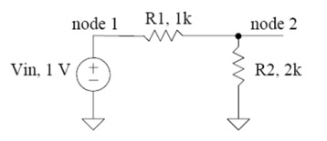
電腦模擬 - II
TF
r1 vin vout 1k
r2 vout vx 2k
vin vin 0 1
v2 vx 0 0
.tf v(vout) vin
.end
small-signal transfer characteristics
v(vout)/vin = 666.6667m
input resistance at vin = 3.0000k
output resistance at v(vout) = 666.6667

Slide 5
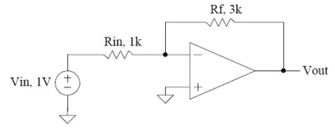
電腦模擬 - III
OP
e1 vout 0 vp vn 1meg
r1 vin vn 1k
r2 vout vn 3k
vin vin 0 1
v2 vp 0 0
.tf v(vout) vin
.end
small-signal transfer characteristics
v(vout)/vin = -3.0000
input resistance at vin = 1.0000k
output resistance at v(vout) = 0.

Slide 6
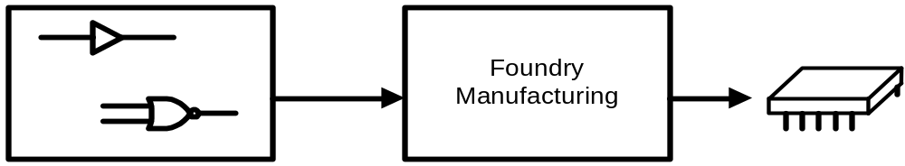
Introduction
Circuit design background
A procedure to predict the circuit/system characteristic after manufacture.
Simulation
&
Layout
TSMC
TSRI
TSRI
國家實驗研究院台灣半導體研究中心

Slide 7
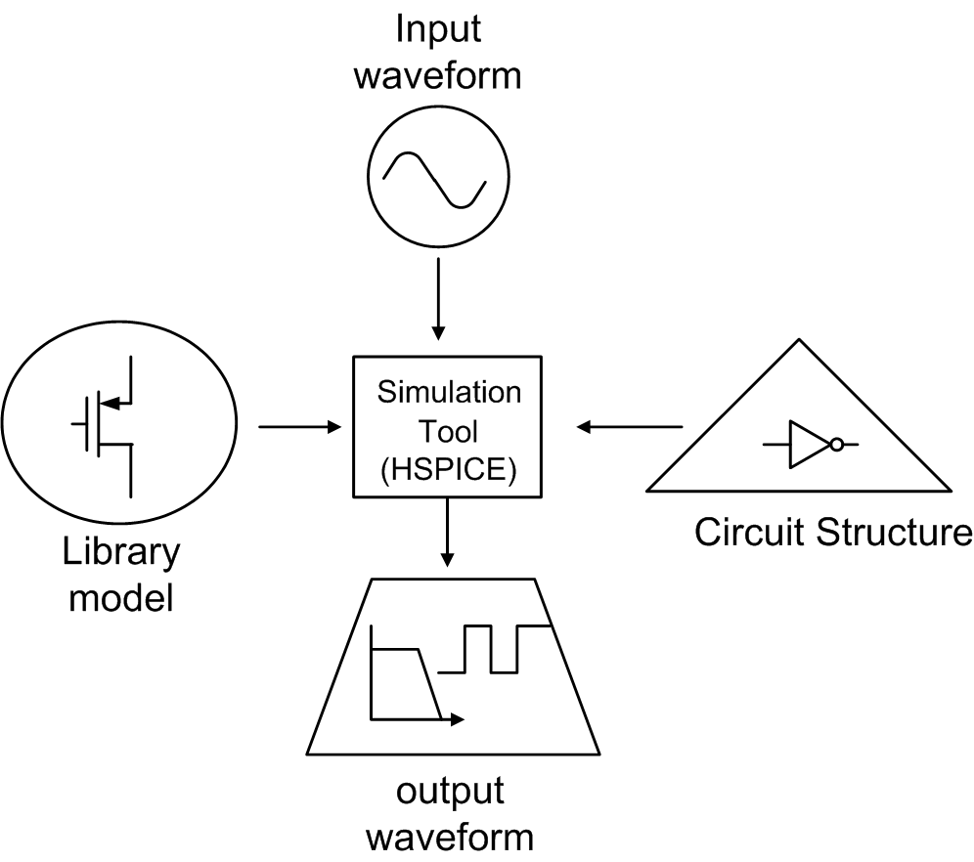
Overview
2) Circuit Simulation background
V1 g vss 10v
I1 sd 0 pulse 0 1.8 …
M1 s g d b …
M2 s1 g1 d1 b …
.lib 'mm018.l' tt
.probe v(node) i1(m1)

Slide 8
.SP structure
TITLE : first line is input netlist file title
.OPTIONS : Set conditions for simulation
.OPTION POST=1 : generate output waveform
Analysis (AC,DC..) : statements to set sweep variables
.PROBE : generate selected signal waveform
.IC or .nodeset : Sets initial state
source (I / V) : input source
Schematic netlist : circuit description
  .Subckt/.ends
.lib or .include : Call library or include some files
.DATA / .param : specify varations
.end

Slide 9
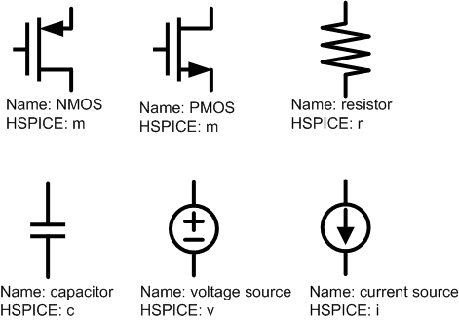
Elements

Slide 10
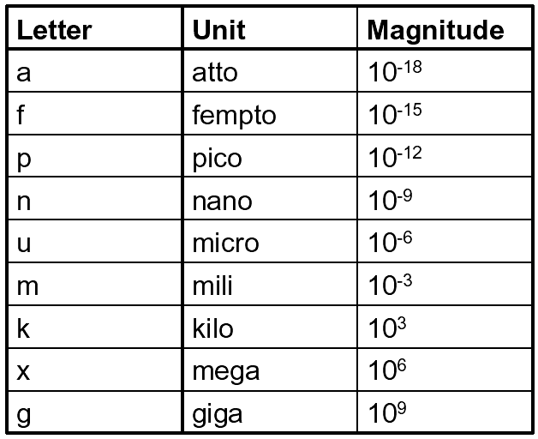
Units
(meg)

Slide 11

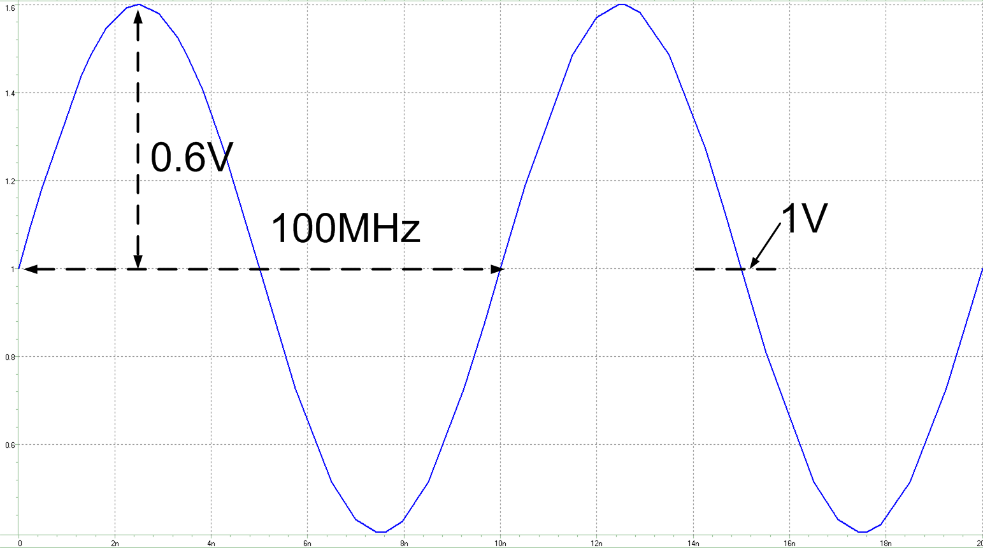

Independent Source (1)
Fixed
  V_{name} Node+ Node- dc value
  Vin in vss dc 1v
Sinusoidal
  V_{name} Node+ Node- sin DC AC Frequency
  Vin in vss sin 1v 0.6v 100meg

Slide 12
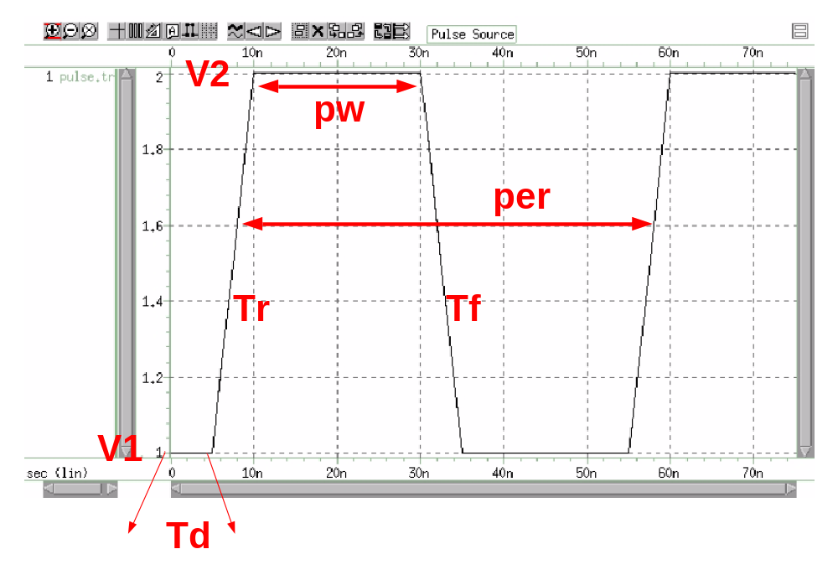
Independent Source (2)
Square-wave
  V_{name} node+ node- pulse V1 V2 Td tr tf pw per
  Vin in vss pulse 1 2 5n 5n 5n 20n 50n

Slide 13
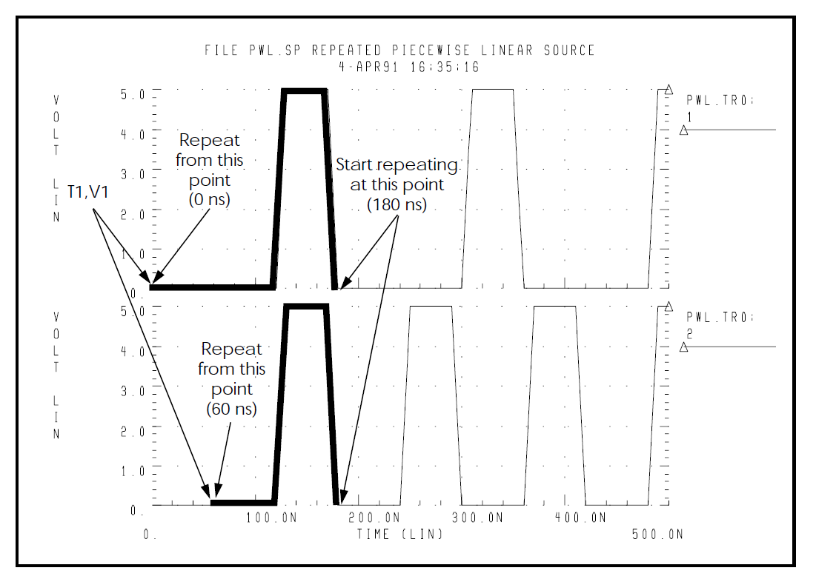
Independent Source (3)
Piece-wise linear
  V_{name} node+ node– pwl t₁ v₁ t₂ v₂ …
  V1 1 0 PWL 0N 0V, 120N 0V, 130N 5V, 170N 5V, 180N 0V, R 0N
  V2 2 0 PWL 0N 0V, 120N 0V, 130N 5V, 170N 5V,180N 0V, R 60N

Slide 14
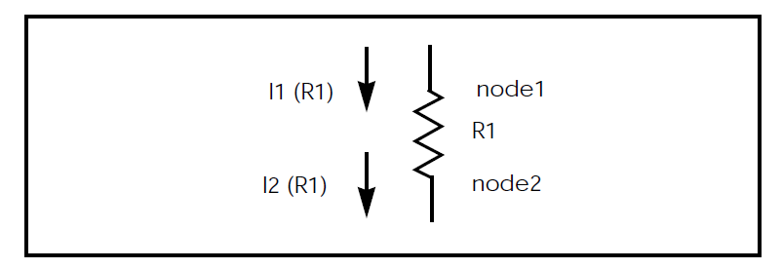
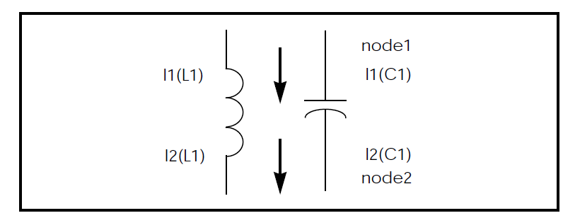
Passive Elements
Resistor
  R_{name} node+ node- value
  R_{load} out vss 50
Capacitor
  C_{name} node+ node- value
  C_{load} out 0 1p

Slide 15
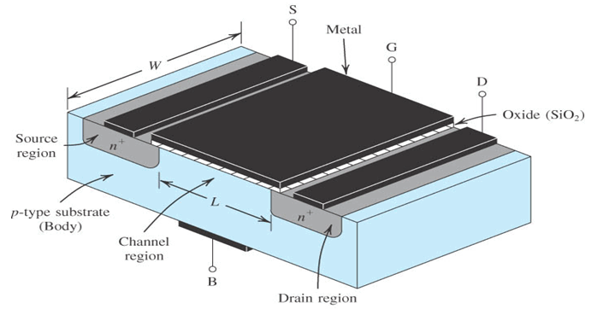
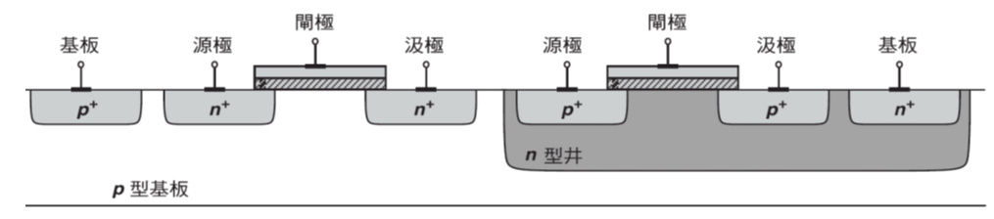
PMOS and NMOS
  M_{name} drain gate source body type W L M
  Mn out in vss vss n_18 w=10u l=1u
  m=1

Slide 16
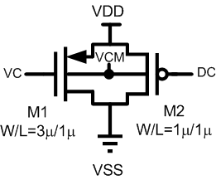
Example
  m1 vss vc vdd vcm p_18 w=3u l=1u m=1
  m2 vss dc vdd vcm p_18 w=1u l=1u m=1

Slide 17
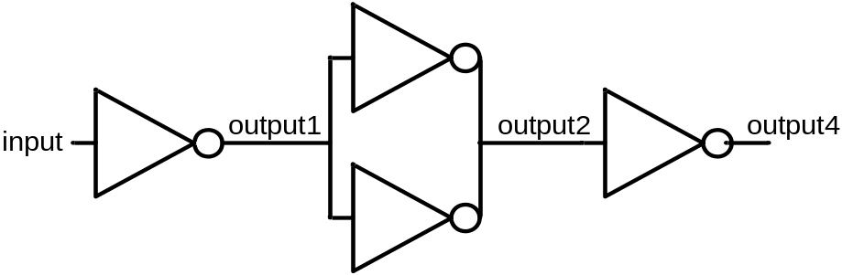
Sub-circuit
.subckt subckt_name node₁ node₂………….node_{n}
…………………………………………………………….
…………………………………………………………….
.ends (subckt_name)
.subckt inverter in out
Mp out in vdd vdd p_18 w=20u l=0.35u
Mn out in vss vss n_18 w=5u l=0.35u
.ends inverter
X_{name} node₁ node₂……..node_{n} subckt_name
Xinv1 input output1 inverter
Xinv2 output1 output2 inverter
Xinv3 output1 output2 inverter
Xinv4 output2 output4 inverter
Define the inputs and outputs of the sub-circuit.
The circuits described between the ‘.subckt’ and the ‘.ends’ statements can be re-used by using the ‘X’ statement.

Slide 18
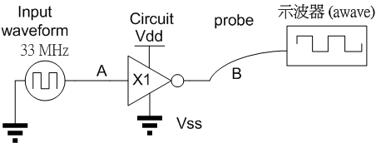
Example
想像在做電子學實驗
Write two file
  inv.sp
    Define all the power, model, waveform
  Inverter.spi
    Write the circuit description (inside the inverter)

Slide 19
inv.sp File
Title. To note what circuit is included in this file. It will be skipped when SPICE is runing.
Inverter
.lib ‘cic018.l' tt
.inc inverter.spi
.options post
.temp 25
.lib command is used to specify the location of the technology library and the corner used in this simulation.
Include the circuit file
Simulation temperature
display the waveform

Slide 20
inv.sp File
.global: Specify the global argument. All nodes with the same name will be treated as the same one.
.global VDD VSS
Vdd VDD 0 dc 1.8
Vss VSS 0 dc 0
.op
.tran 50p 100n
.probe v(a) v(b)
V1 a vss PWL 0N 0V, 10N 0V, 11N 1.8V, 15N 1.8V, 16N 0V, R 0N
X1 a b inv
.end
Global ground.
.op: DC operating point analysis.
.tran: transient analysis. Time step is 50ps and stop time is 100ns
.probe: display the node waveform
Input waveform : voltage or current source
recall the subcircuit from circuit file (inv.spi)
Last line of SP file

Slide 21
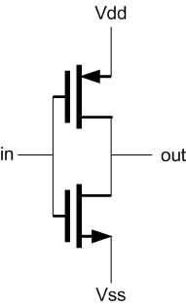
inverter.spi file
Inverter circuit

Slide 22
inverter.spi file
Title of spi file
This spi file for inverter
.global vdd vss
.subckt inv in out
Mp out in vdd VDD p_18 l= 0.35u w= 20u
Mn out in VSS VSS n_18 l= 0.35u w= 4u
.ends
.global: Specify the global argument. All nodes with the same name will be treated as the same one.
Subckt: make all the circuit as module. Easy for re-use this curcit
Inverter circuit in HSPICE code
Last line for Subckt

Slide 23
單一檔案 inv.sp
Inverter
.lib ‘cic018.l' tt
.options post
.temp 25
global VDD VSS
Vdd VDD 0 dc 1.8
Vss VSS 0 dc 0
.op
.tran 50p 100n
.probe v(i) v(o)
V1 i vss PWL 0N 0V, 10N 0V, 11N 1.8V, 15N 1.8V, 16N 0V, R 0N
Mp o i VDD VDD p_18 l= 0.35u w= 20u
Mn o i VSS VSS n_18 l= 0.35u w= 4u
.end

Slide 24
VMware Installation

Slide 25

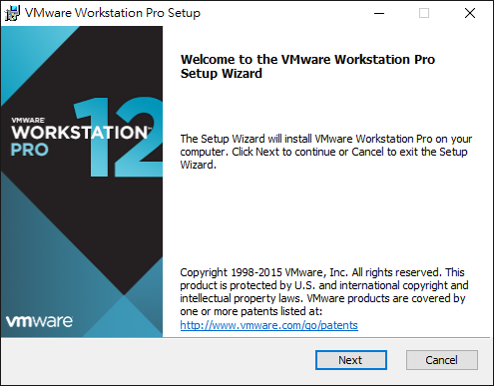
VMware Installation

Slide 26
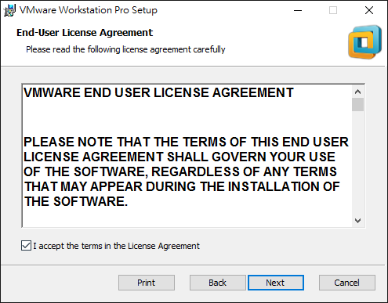
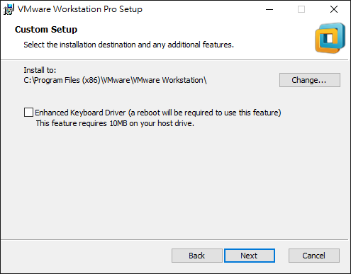
VMware Installation

Slide 27
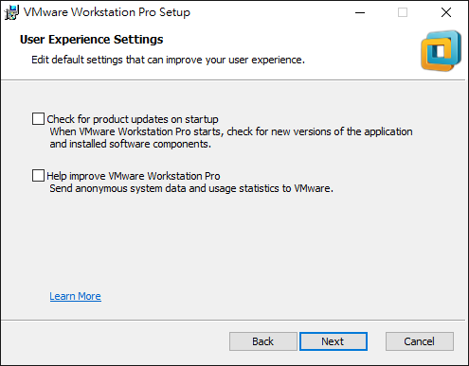
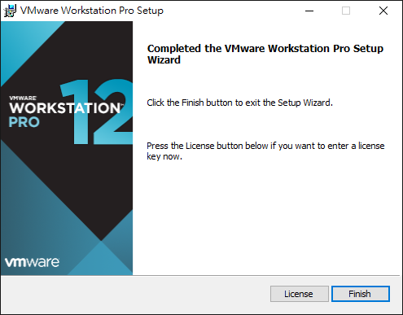
VMware Installation

Slide 28
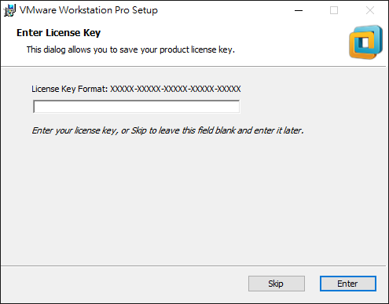
VMware Installation
Use ‘keygen.exe’ to generate the license key.

Slide 29
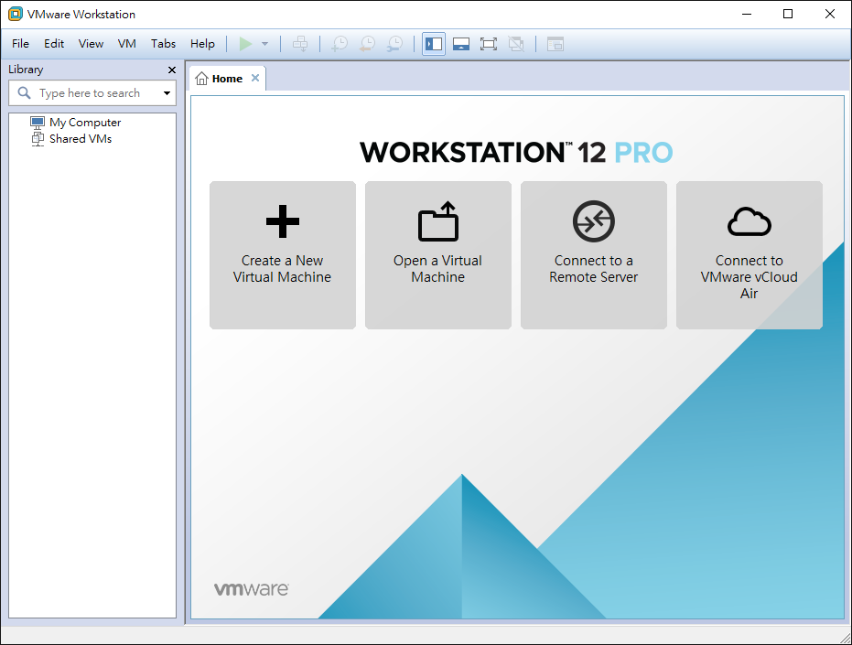
Set up Linux

Slide 30
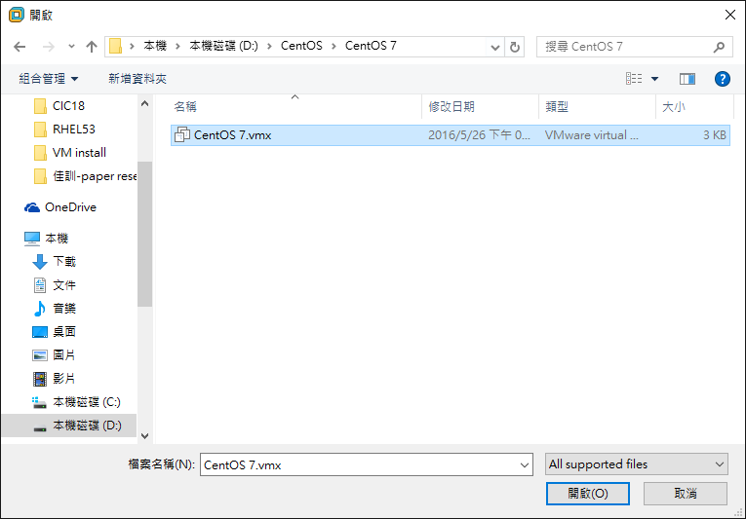
Set up Linux

Slide 31
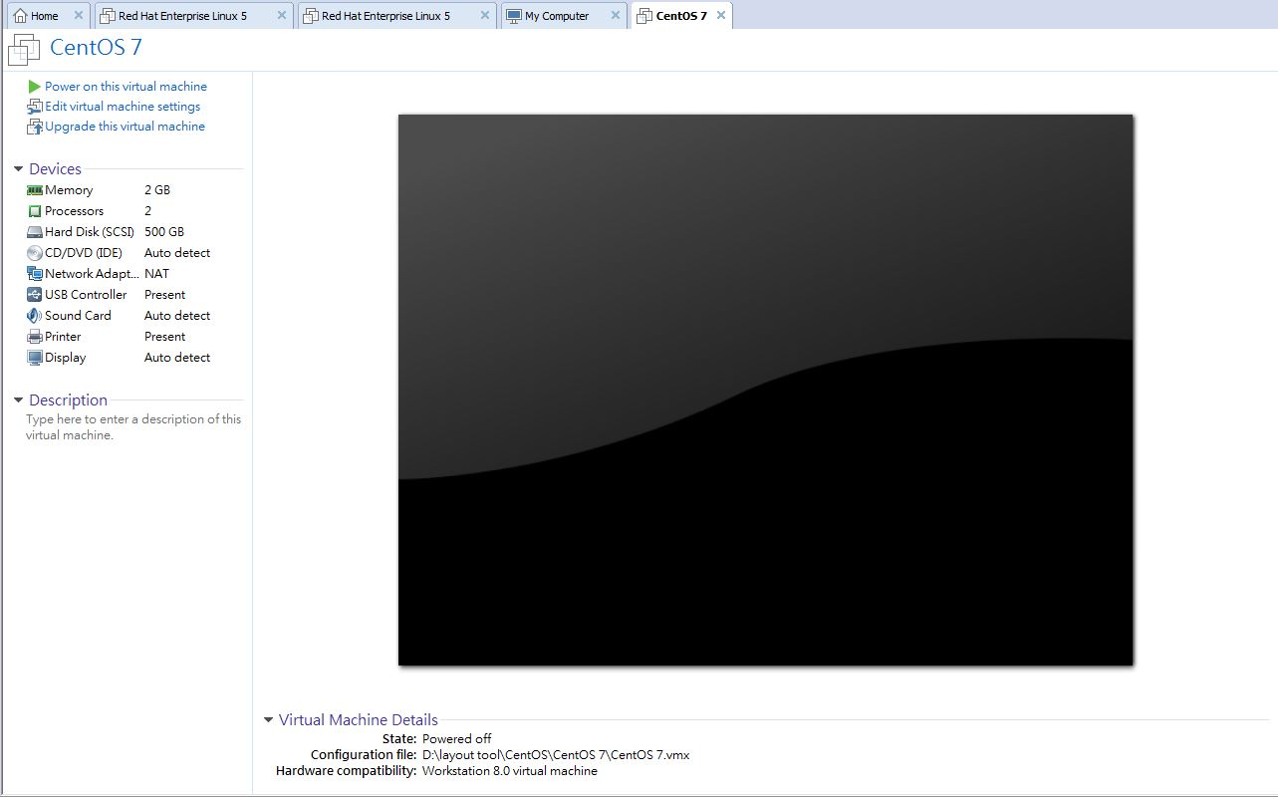
Set up Linux
點它

Slide 32
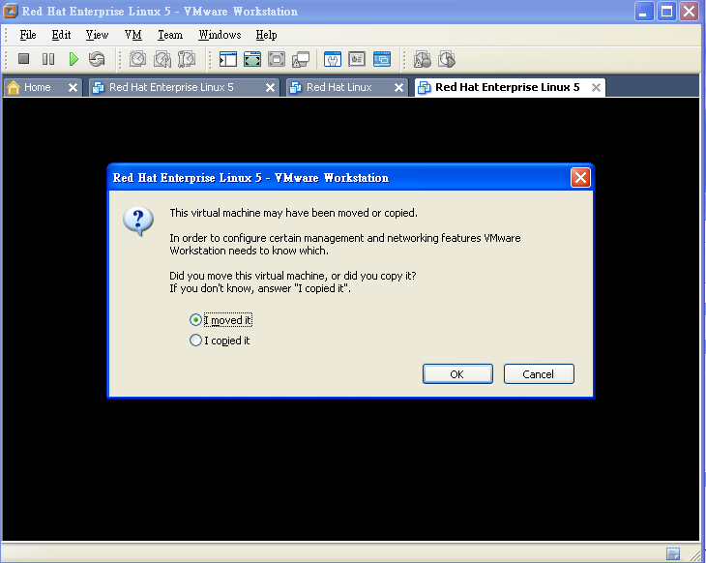
Set up Linux
第一次使用VM連結CentOS 會出現此視窗
選move

Slide 33
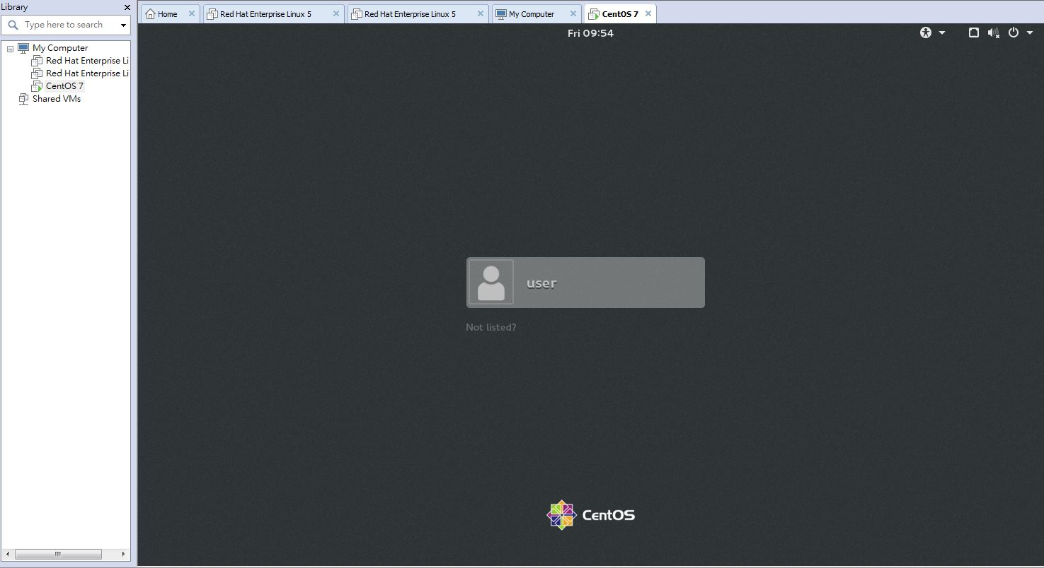
Set up Linux
點user 打 Password
Password : 123456

Slide 34
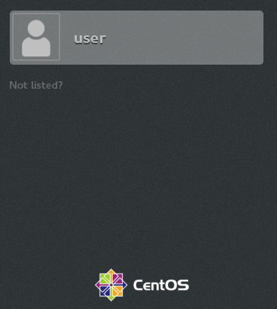
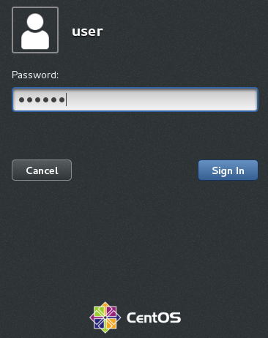
Centos Linux
Account：user
Password：123456

Slide 35

Centos Linux

Slide 36
Run SPICE

Slide 37
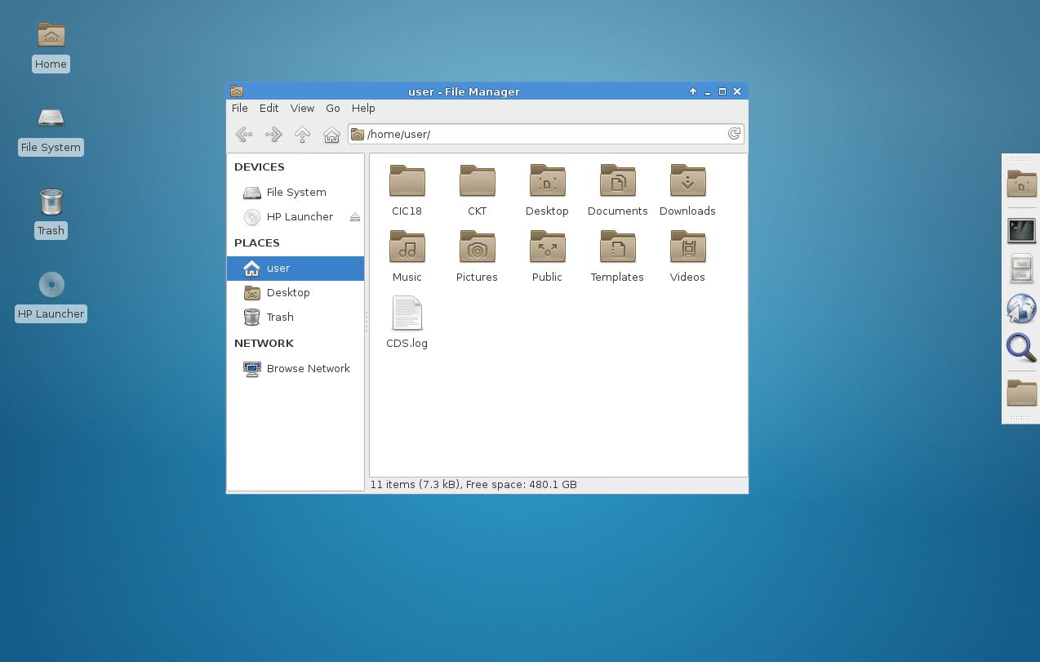
開啟 Home (檔案總管)
2
點我
1

Slide 38
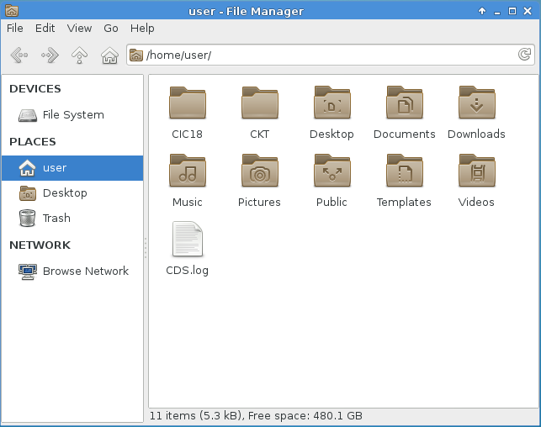
Home folder
2.
1.
1.CKT is for circuit simulations
2.CIC18 is for layout

Slide 39
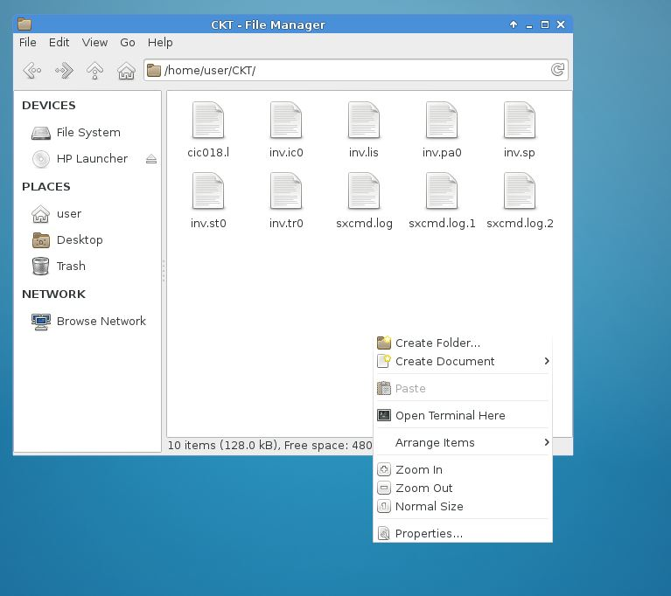
Home –> CKT folder
紅色區域內按滑鼠右鍵跳出此視窗
選 “Open Terminal Here”

Slide 40
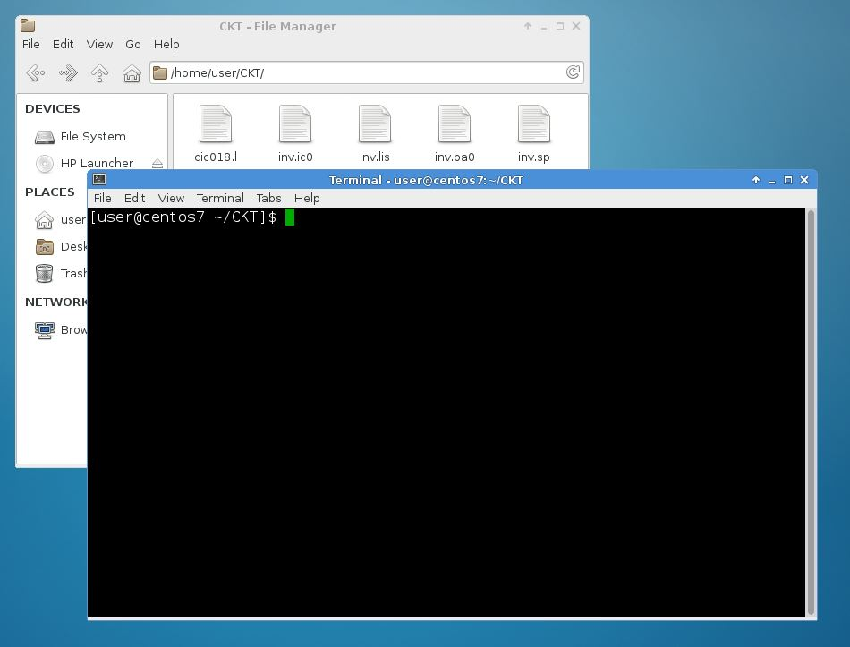
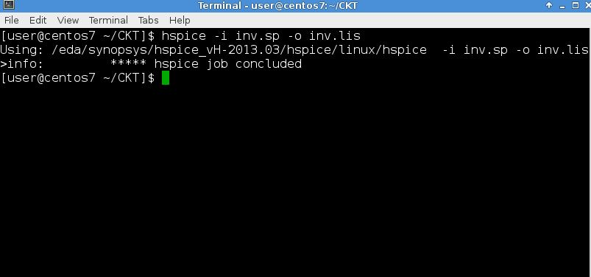
HSPICE - I
Terminal 視窗
鍵入 hspice –i inv.sp –o inv.lis

Slide 41
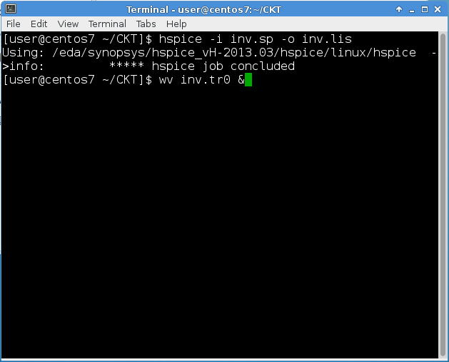
Instructions：Run WaveView interface
simulation finished
wv：waveview instruction
inv.tr0：transient simulation result file
&：make instructions executed in the background process, that makes terminal be able to execute the next instructions.

Slide 42
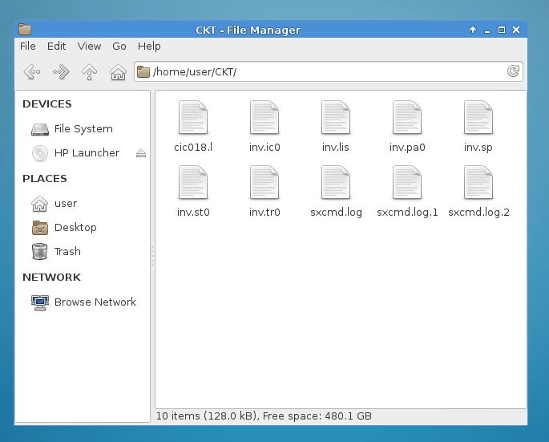
HSPICE - 資料夾
HSpice 文字輸出檔
HSpice 撰寫檔
HSpice 圖檔

Slide 43
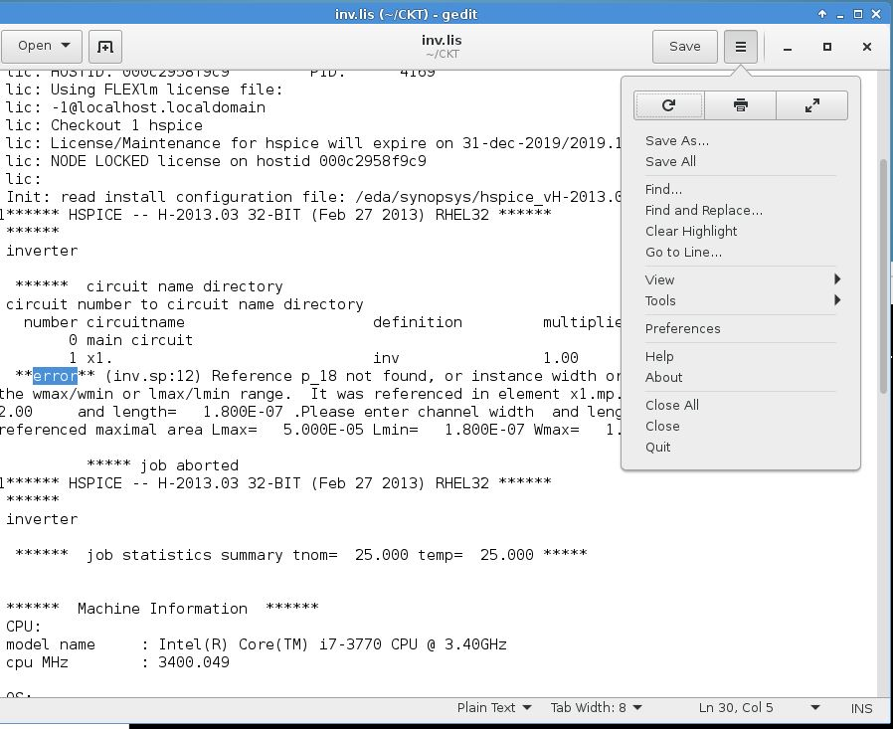
HSPICE – 檢查是否有錯??
錯誤會出現在 inv.lis檔案中
不能有任何
error
打error

Slide 44
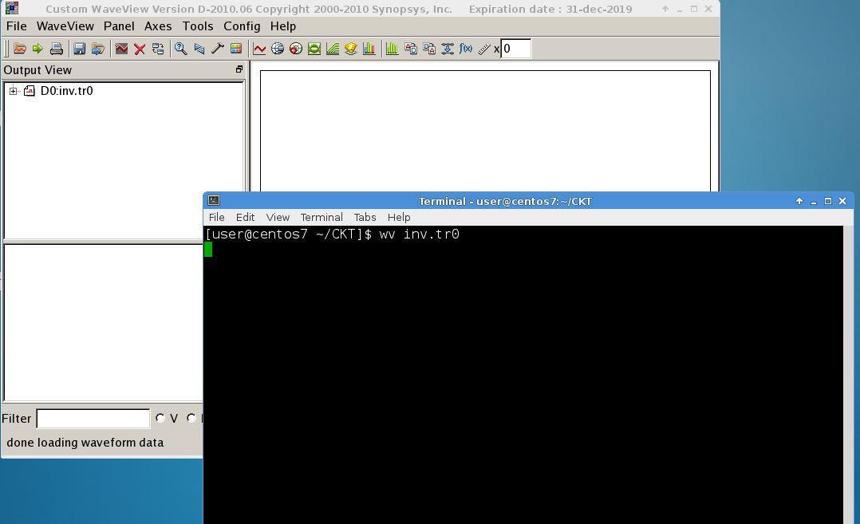
看模擬圖
在 Terminal 中
打 wv inv.tr0
xx.tr﹟ : transient analysis result
xx.ac﹟ : AC analysis result
xx.sw﹟ : DC analysis result

Slide 45
看模擬圖
選電路中節點(node)看電壓
input
output

Slide 46
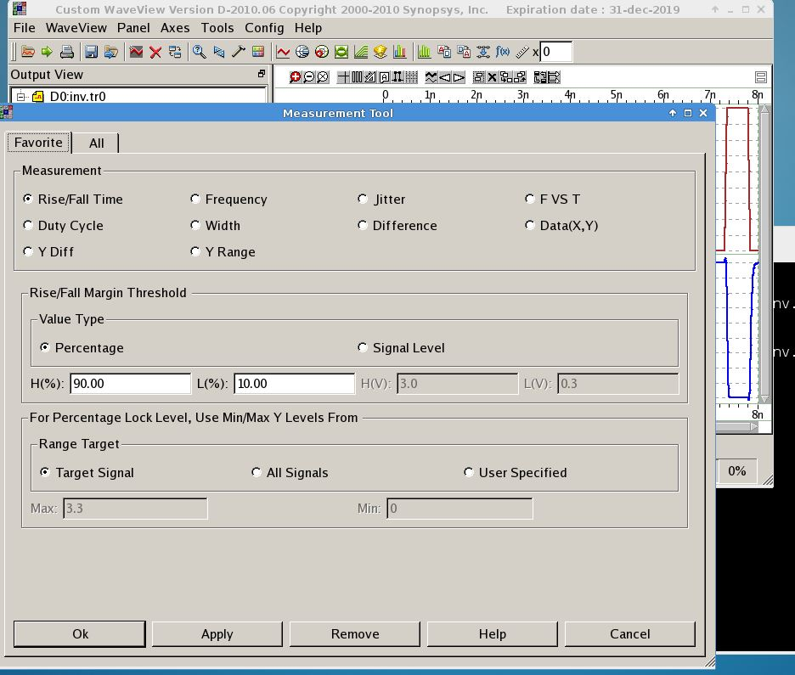
量測波形 模擬圖
點我

Slide 47
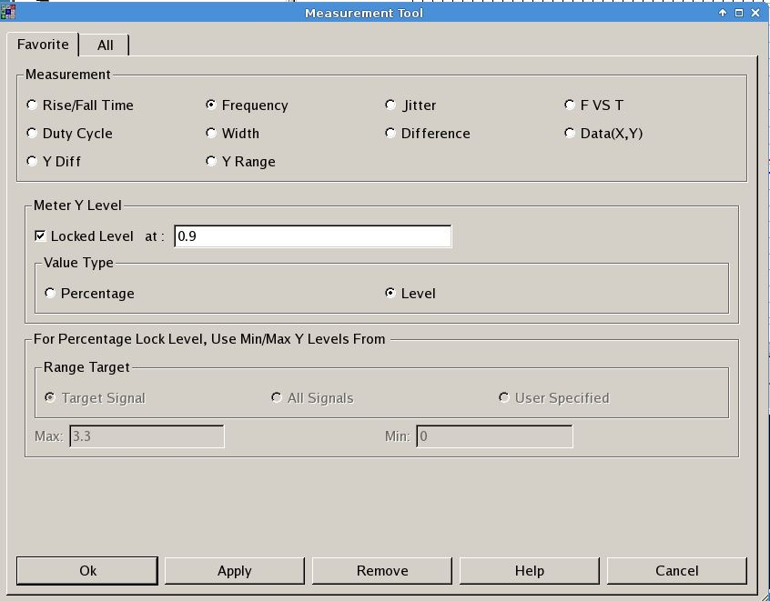
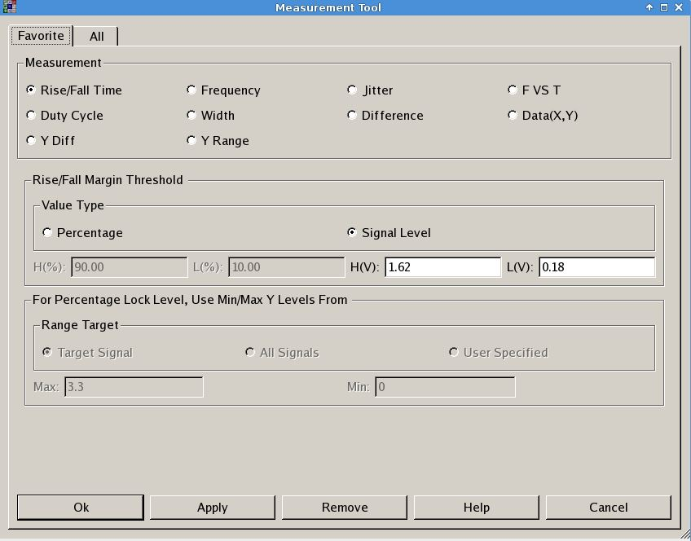
量測 頻率和上升緣 - I
頻率
上升緣
選Signal Level 打
  H(V): 1.62 (VDD*0.9)
  L(V): 0.18 (VDD*0.1)
選Level 打1/2 VDD = 0.9 V

Slide 48
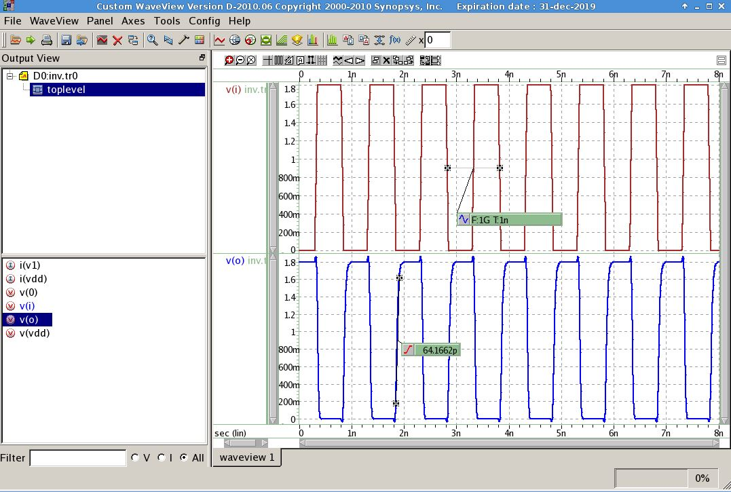
量測 頻率和上升緣 - II

Slide 49
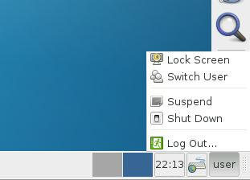
CentOS關機方法
選 “Shut Down”
可以關掉CentOS

